Slide 1
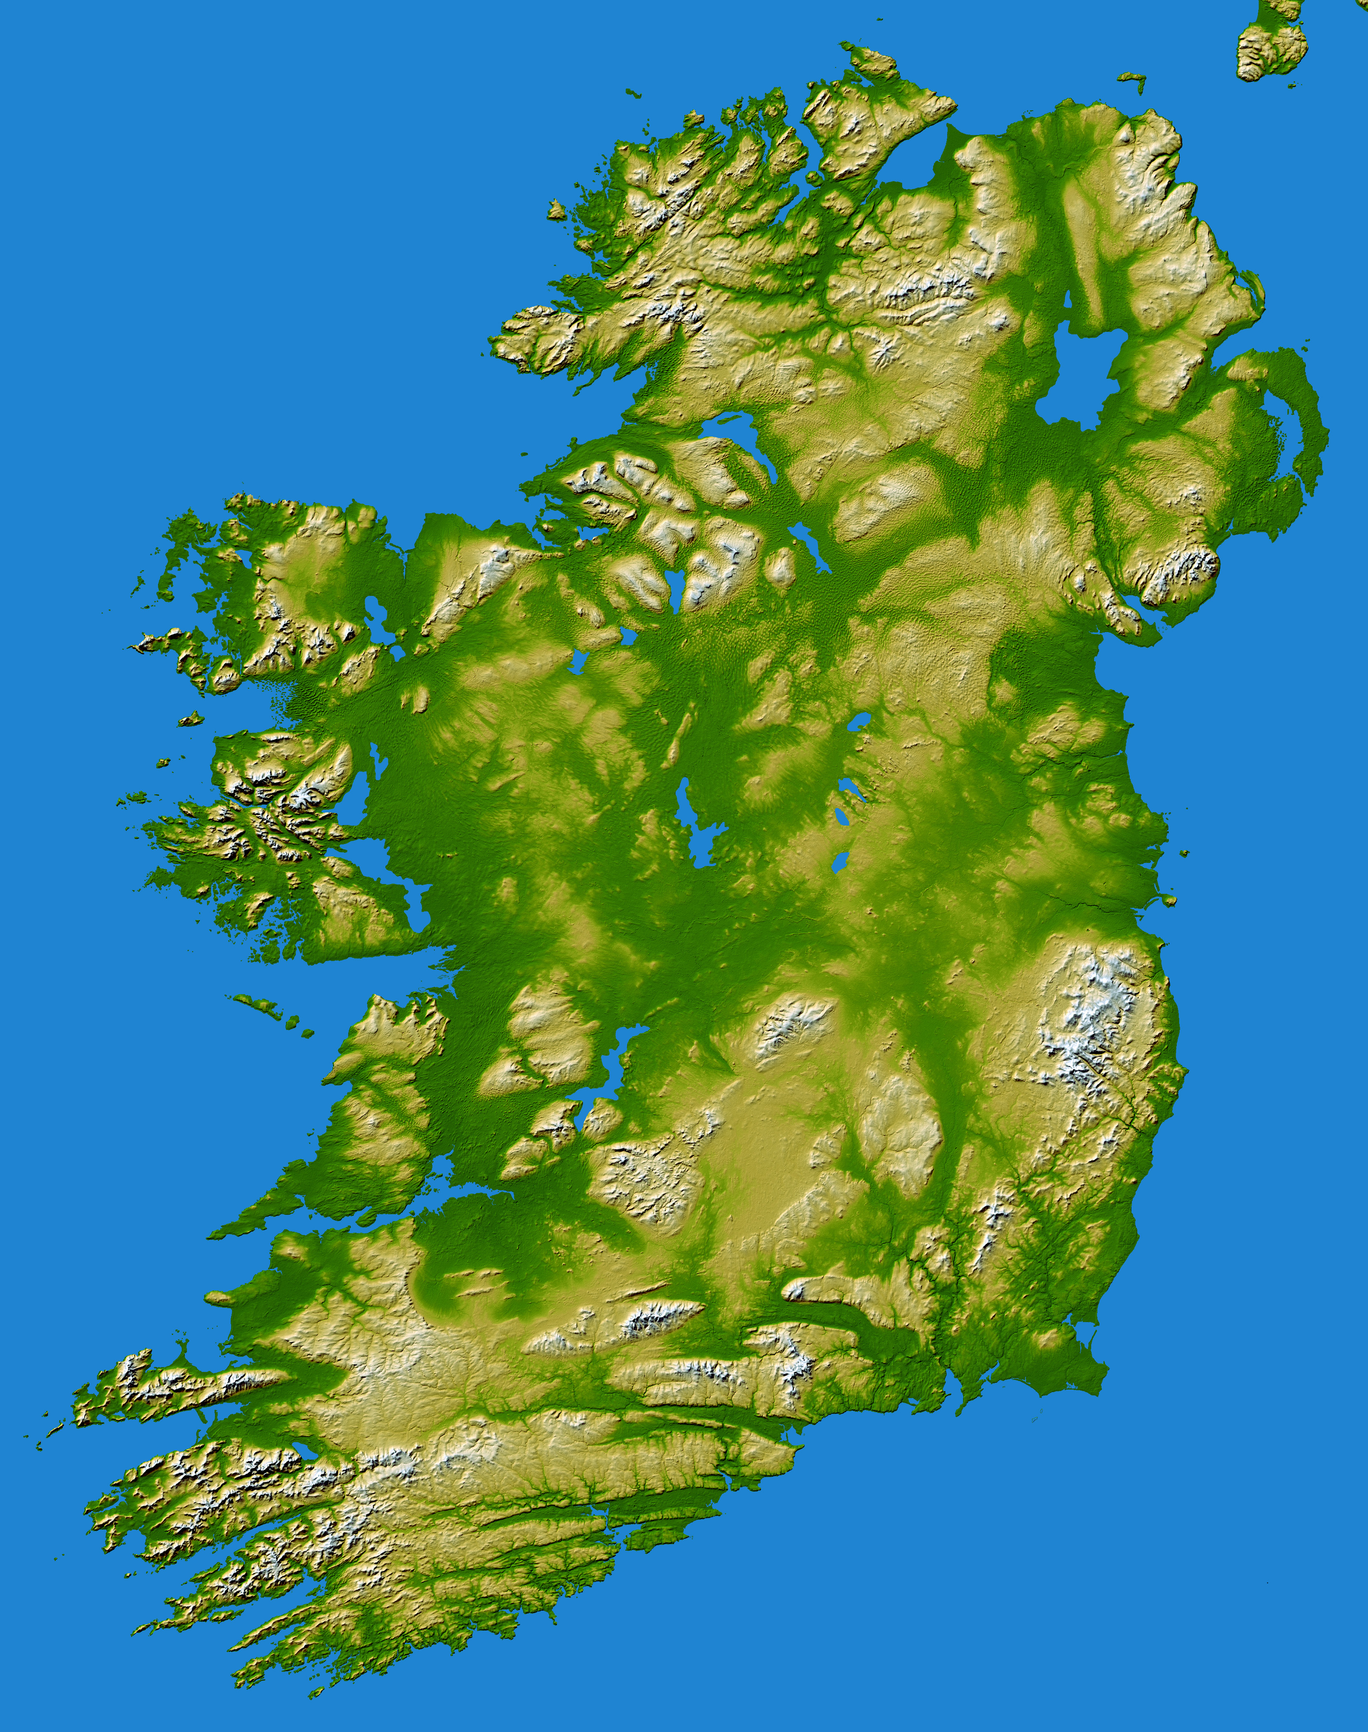
Irish geohazards and how we monitor and mitigate them
This Photo by Unknown author is licensed under CC BY-SA.

Slide 2
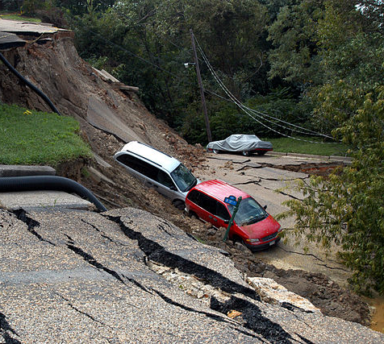
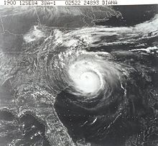
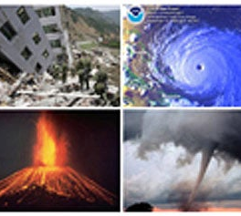
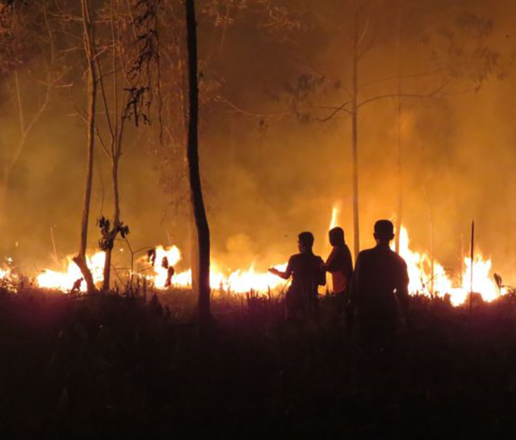
Geohazards?
This Photo by Unknown author is licensed under CC BY-SA-NC.
This Photo by Unknown author is licensed under CC BY-SA-NC.
This Photo by Unknown author is licensed under CC BY-SA.
This Photo by Unknown author is licensed under CC BY-SA-NC.

Slide 3
What are geohazards??
They are naturally occurring geological and environmental conditions that can cause damage, loss of property and or life. They involve long or short-term geological processes.
Examples
Earthquakes
Landslides
Tsunamis
Flooding
Other examples??

Slide 4
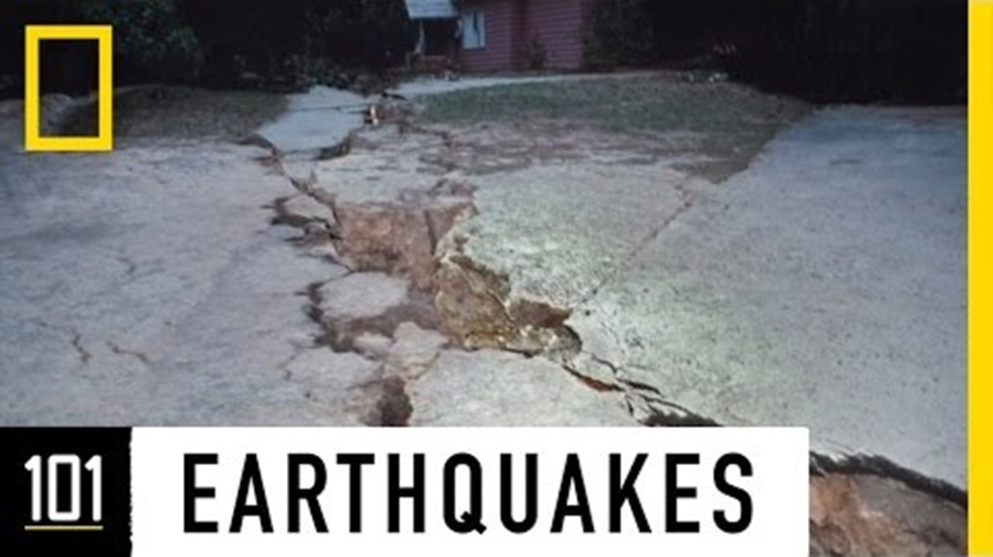
An earthquake is a vibration of the earth’s surface caused by the sudden release of energy beneath the crust.
Around 8,000 earthquakes occur on average every year, of which approximately 1,000 are strong enough to be felt. About 40 of these result in major damage and, on average, 8,000 people are killed by the effects.
Focus: This is the point inside the earth’s crust where the earthquake originates. The focus can be:
Shallow focus earthquakes occur close to the earth’s surface, 0–70 km in depth
Intermediate focus earthquakes occur between 70 and 300 km under the surface
Deep focus earthquakes occur over 300 km below the surface of the earth.

Slide 5
Where Earthquakes occur – converging boundaries
The deepest, most powerful earthquakes occur where plates collide. Massive friction is caused between layers of rock at subduction zones when an oceanic plate is in collision with another tectonic plate

Slide 6
Diverging Boundaries
Earthquakes occur along the fractures that appear as two plates separate from one another.
Many earthquakes occur along the Mid-Atlantic Ridge but often go unnoticed as no lives are lost and no damage occurs.

Slide 7
Transform Boundaries
When two plates slide past one another, rocks at the edge of both plates lock in position.
Stress builds at the boundary as convection currents try to push the plates past each other.
Powerful earthquakes have been recorded at the San Andreas Fault, which runs along the western edge of California, when this energy has been released.

Slide 8
Global Earthquakes! - IRIS seismic monitor
Pacific ring of fire
Choose specific location and gather information
Most recent:
-Magnitude
-location

Slide 9
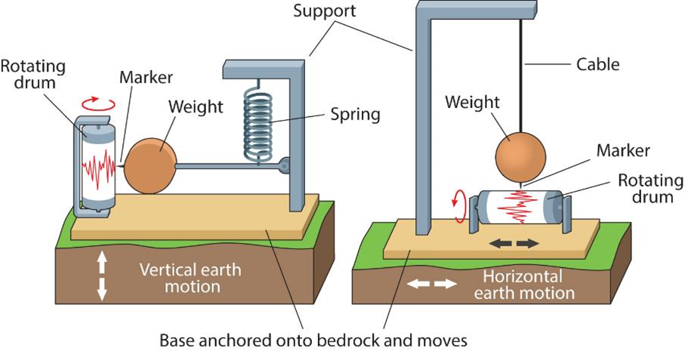
Seismographs
Seismologists use an instrument called a seismograph to detect and record earthquake activity. Seismographs measure the intensity of seismic waves which can shake and displace the land on the earth’s crust both horizontally (sideways) and vertically (up and down). They generate a graph called a seismogram.
Homemade seismogram

Slide 10
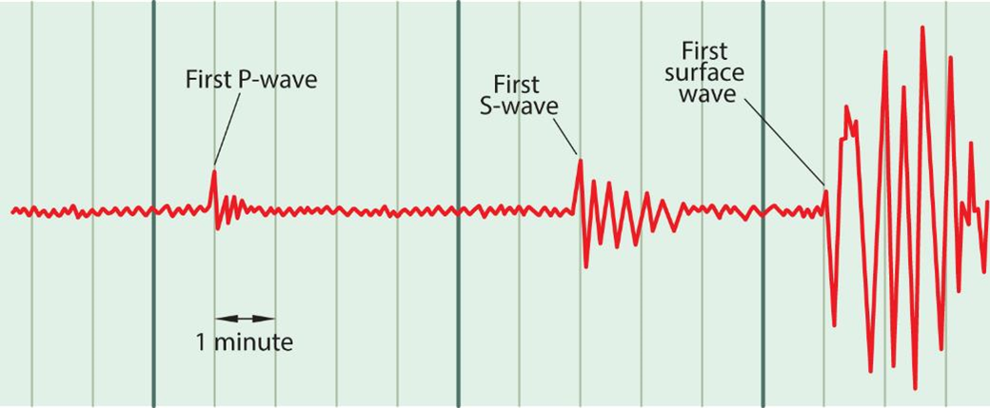
Seismic Waves
There are two categories of seismic wave:
1.Body waves: Two types of body wave travel through the earth’s inner layers, arriving at different times.
a. Primary waves (P-waves) are the first wave of an earthquake to arrive. These are the fastest travelling seismic waves and they move through solid rock, liquids and gases.
b. Secondary waves (S-waves) are the second wave of an earthquake. Travelling at medium speeds, they can only move through solid rock. Secondary waves cause the ground to move perpendicular to the direction the wave itself travels.
2. Surface waves are the last to arrive and travel at the slowest speed. Moving along the surface of the earth like ripples on water, they’re responsible for most of the damage caused by earthquakes.
P and S waves animation

Slide 11
The Richter Scale
Developed by Charles Richter in 1935, it allows seismologists to accurately record the magnitude of seismic activity.
The Richter scale:
•Uses seismograph readings to calculate one internationally-accepted magnitude for each earthquake;
•is an open-ended scale – the highest earthquake magnitude recorded is the highest number on the scale;
•is a logarithmic scale – each full number on the scale represents ground movements 10 times greater than the number before it – magnitude 7 earthquakes are 10 times stronger than magnitude 6 earthquakes, etc.
Draw a suitable graph to represent this data

Slide 12
Irish Geohazards and the GSI
The Geohazards programme supports the GSI's –Geological Survey of Irelands research roadmap by carrying out research in areas related to Irish Geohazards (landslides, tsunami, earthquakes). The programme links with several national and international research groups, agencies and organisations.
12 projects related to Geohazards were funded through the GSI Short Calls Programme. Topics covered included landslides, seismicity, coastal erosion, sinkholes development, engineering properties of interglacial deposits, radon, and ancient flood plains.
Our Focus = Earthquakes and seismic activity in Ireland and groundwater and flooding.

Slide 13
Irish Earthquakes!
INSN website
Map with earthquake activity since 1980.
Size of earthquakes/ locations/ fault lines and seismic stations.
Recent seismic events- quarry blasts and earthquakes
Killiney Beach History
Robert Mallet Father of Seismology

Slide 14
Groundwater and Flooding
Seismometers monitor groundwater before it gets to the surface
Radar and satellites monitor surface flooding
GSI - groundwater look at map all data screen- groundwater vulnerability and bedrock geology Ground water data veiwer map
Floodmaps look at flood maps- pick a location and assess suitability for building a house
Ground water flood project

Slide 15
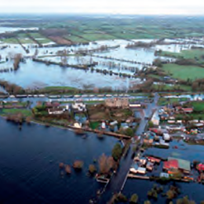
Areas with potential for flooding
Rivers – Floodplains.
River Shannon- winter flooding has become more severe due to artificially high-water levels in its loughs as a result of Ardnacrusha dam and HEP station
Karst-limestone- permeable.
Turloughs- depressions on the surface of limestone areas. During long periods of rain, they fill up and become seasonal lakes. As the weather improves , the water table drops, and they dry up as the water percolates underground

Slide 16
Gort flooding time lapse

Slide 17
Human Interaction with Rivers
Rivers are an important resource for humans. Some of the main uses are:
•Hydroelectric power
•Transportation
•Flood control
•Irrigation
•Urban water supply
•Recreational use

Slide 18
Monitoring the earth by satellite radar

Slide 19
Satellite flood monitoring of Ireland!
Shannon satellite flood images
Mapping floods from space

Slide 20
The River Shannon – Drainage and Transport
The Shannon is Ireland’s longest river, flowing 360 km through 11 different counties.
Due to its flat profile, the river has low velocity, meaning it provides poor drainage for the surrounding agricultural land.
A number of schemes have been undertaken since 1755 but the issue of flooding has not been greatly improved

Slide 21
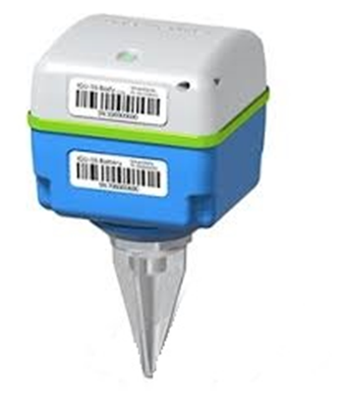
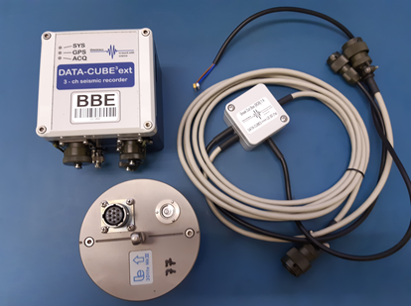
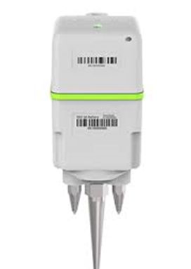
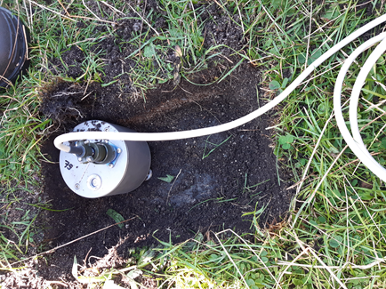
Seismic instruments
Broad-band Seismometer
Short-period Seismometer
Geophone

Slide 22
How can we record water flow signature via
“seismology”?

Slide 23
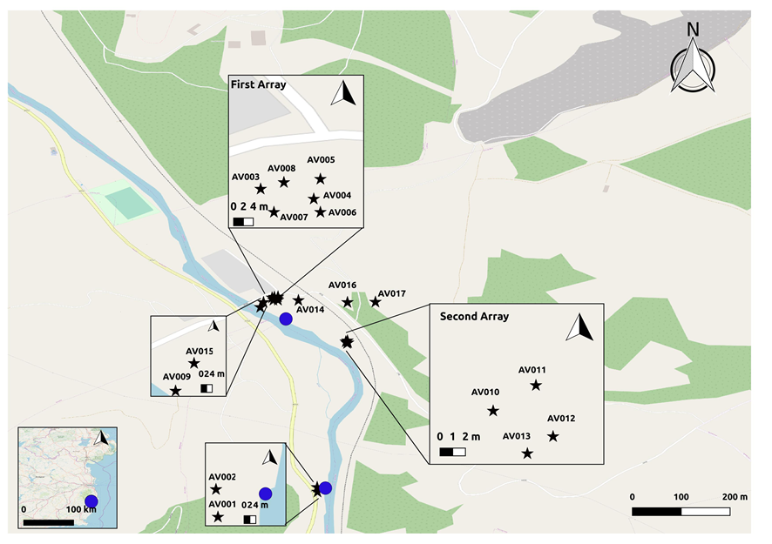
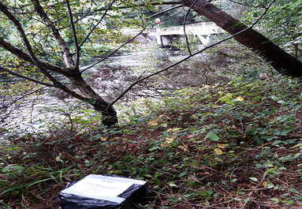
Avoca River Experiment- Co. Wicklow- Oct. 2019

